Slide 1
Performance
CS 0447
Jarrett Billingsley

Slide 2
Class announcements
wow I feel so much better today :)))))) so weird :)))))))))))))))))
there are plenty of exercises that go with today’s lecture on the Materials > Exercises page, so go practice those after class/when you’re reviewing for the FINAL, AAAAAAA

Slide 3
Scientific Notation and SI Prefixes

Slide 4
Numbers mean science
when dealing with tiny fractions of a second or many operations per second, scientific notation is the best representation.
small numbers have negative exponents. large numbers have positive exponents.
1.83 × 10⁻⁵
= 0.0000183
7.50 × 10⁷
= 75,000,000
when you move the decimal point left, you add to the exponent.
75.0 × 10⁶
= 7.50 × 10⁷
18.3 × 10⁻⁶
= 1.83 × 10⁻⁵
-6 + 1 = -5!!!
and when you move the decimal point right, you subtract from the exponent.
Notes:
- adding/subtracting to the exponent fucks me up too

Slide 5
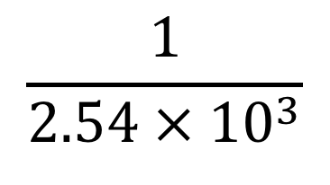
Reciprocals…
probably one of the most common mistakes:
negate the exponent…
$$\frac{1}{A × {10}^{n}}=\frac{1}{A }× {10}^{−n}$$
and get the reciprocal of the significand!!!
$$\frac{1}{2.54 × {10}^{3}}$$
= 0.394 × 10⁻³
= 3.94 × 10⁻⁴
Notes:
- do you know how many times I have had to write "1/8 != 8" on exams? do you?

Slide 6
Multiplication is commutative and associative
scientific notation makes certain kinds of math much easier. do not take things out of scientific notation until the end.
for example, when multiplying, you group the significands together, and add the exponents of the bases.
(4.9 × 10²) × (7.2 × 10⁸) × (3.3 × 10⁻⁵)
= (4.9 × 7.2 × 3.3) × (10² × 10⁸ × 10⁻⁵)
= 116.424 × 10⁵
= 1.16424 × 10⁷

Slide 7
SI Prefixes
we deal with some pretty big and small numbers.
it's good to memorize these prefixes.
(T)era | 10¹²
(G)iga | 10⁹
(M)ega | 10⁶
(k)ilo | 10³
(m)illi | 10⁻³
(µ)icro | 10⁻⁶
(n)ano | 10⁻⁹
(p)ico | 10⁻¹²
for practical reasons, micro is sometimes typed as u (e.g. 10 us instead of 10 µs)

Slide 8
Engineering Notation
this is a variety of scientific notation where you keep the exponent a multiple of 3, so it always corresponds to an SI prefix.
(SI prefixes are just a shorthand for powers of 10 anyway.)
Standard
Engineering
SI Prefix
1.83 × 10⁻⁵ s
= 18.3 × 10⁻⁶ s
= 18.3 µs
you can do this at the end of a sequence of computations, while using standard scientific notation in the intermediates.

Slide 9
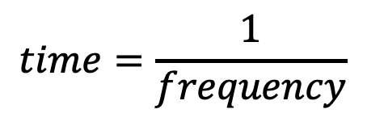
Time and frequency
the SI unit for time is seconds (s). but what is frequency?
frequency measures how often a periodic, repeating event occurs.
the SI unit for frequency is Hertz (Hz), and the relationship between time and frequency is simple:
$$frequency=\frac{1}{time}$$
$$time=\frac{1}{frequency}$$
in other words, they are inverses. 1 Hz = 1/s = s⁻¹.
a more “intuitive” definition of Hz is “events per second.” whenever you have “per” in a unit, that is a division!
Notes:
- “meters per second” = m/s (or ms⁻¹)

Slide 10
What is performance?

Slide 11
The layman's understanding
your ancient computer takes forever to open the browser.
you get a new computer. it opens the browser almost instantly.
which computer is faster?
yeah but this is computer science, not computer guessing.
science means numbers and measurement.
Notes:
a lot of science is guessing tho.
my god, that Surface pic has the windows 8 start screen on it. guess that’s out of date! oh well!

Slide 12
So let’s talk about chairs
let’s say you get really into woodworking and start making chairs.
it takes you 4 hours to make one chair.
you work for 8 hours a day.
how many chairs can you make in one day?
4 hours
4 hours
yes… numbers… science…

Slide 13
More chairs means more money
you want to make more chairs each 8-hour day.
what are two different ways that you could make 4 chairs in 8 hours?
Notes:
<this slide intentionally left blank>
ask someone who was in class.

Slide 14
Latency and throughput
latency is how long a task takes to complete.
latency is measured as seconds per task.
throughput is how many tasks you can complete in a span of time.
throughput is measured in tasks per second.
improving latency means reducing the amount of time that one task takes.
4 hours
2 hours
4 hours
improving throughput can mean increasing the amount of work being done at once.
4 hours
4 hours
but it’s a little more subtle than that…
Notes:
yes we’re talking about something that takes hours to complete, but you can still measure that in seconds. a lot of seconds.
“amount of work being done at once” is more properly called “instantaneous throughput” – how much work is being done at one instant. if you measure the throughput over a longer time period, you are actually getting an average of the instantaneous throughputs over time.

Slide 15
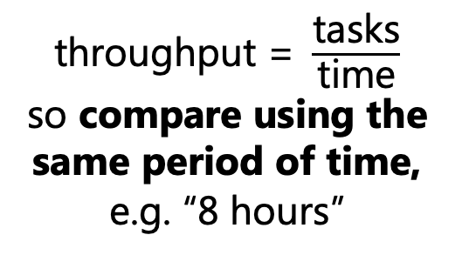
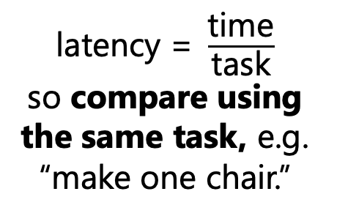
Making fair comparisons, and what “better” means
sometimes latency is more important; other times throughput is.
if you want to compare latencies or throughputs of different things, you have to fix the denominator to make a fair comparison.
$\text{latency}\text{ = }\frac{\text{time}}{\text{task}}$
so compare using the same task, e.g. “make one chair.”
4 hours
the one with the shortest latency is the best.
2 hours
3 hours
the one with the highest number of completed tasks is the best.
$\text{throughput}\text{ = }\frac{\text{tasks}}{\text{time}}$
so compare using the same period of time, e.g. “8 hours”
Team 1
Team 2
Team 3

Slide 16
Improving latency can improve throughput
since these two measures are kind of reciprocals, making latency lower can make throughput higher!
if one person improves their speed and can make a chair in half the time…
4 hours
4 hours
…then the throughput doubles as a result.
2 hours
2 hours
2 hours
2 hours
this is a fair comparison of throughput, since the denominator – time period – stayed the same: 8 hours in both cases.

Slide 17
Improving throughput can improve latency… to a point
someone orders 9 chairs, and they need them done ASAP.
how long will it take to make all 9 chairs, assuming one person can make a chair in 4 hours?
with one person:
36 hours
4 hours
4 hours
4 hours
4 hours
4 hours
4 hours
4 hours
4 hours
4 hours
with two: 20 hours
4 hours
4 hours
4 hours
4 hours
4 hours
4 hours
4 hours
4 hours
4 hours
this is a fair comparison of latency, since the denominator – the number of tasks – stayed the same: 9 chairs in both cases.
but notice: the latency did not get cut perfectly in half by doubling the throughput! sometimes that happens.
Notes:
- whenever you have tasks that can’t be “stopped in the middle” (like making a chair), you’ll run into this. now in reality, that 9th chair could probably be worked on by 2 people at the same time, but blah blah it’s an example okay

Slide 18
Applying it to a CPU
the CPU's job is to run instructions. so we could finish instructions faster by either…
doing each instruction faster (i.e. reduce the latency), or
executing more instructions at once (i.e. increase the throughput)
for a long time, we did the former…
clock speed increased by 3 orders of magnitude from 1980 to 2000
but then we hit a wall.
and that's when multi-core CPUs became common.
this is a massive oversimplification of what really happened but it’s an accurate-enough story.
Notes:
- we were increasing throughput like crazy in the 90s too, but with instruction-level parallelism rather than multiple cores… but that’s CS 1541 stuff, so.

Slide 19
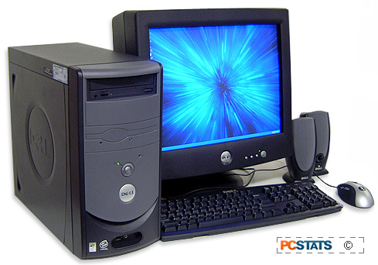
Reducing latency
it’s 2001 and you put a new Pentium 4 in your sweet Dell. it executes an instruction in only 0.8ns compared to your old CPU.
1.6ns
1.6ns
1.6ns
.8ns
.8ns
.8ns
.8ns
.8ns
.8ns
if each instruction takes only 0.8ns, that means 0.8ns between clock pulses. How fast is the clock running?
$$\begin{matrix}\frac{1}{0.8×{10}^{−9}s} & =1.25×{10}^{9}Hz \\ & =1.25 GHz\end{matrix}$$
(frequency = 1/time)
well how fast could we possibly make it run?

Slide 20
Real-world clocking issues

Slide 21
Propagation Delay
propagation delay is the time it takes for a signal to pass through a circuit.
in a loop-shaped circuit, it’s how long it takes for the signal to make "one lap" around the loop.
during that delay, the outputs are invalid (they can fluctuate).
after that delay, the outputs are valid.
if you try to use the output while it's invalid, things break!
stuff like 2 + 2 = 17… remember the ripple carry adder?
so there are real, physical limits to how fast a processor can run!
Notes:
- so it stands to reason: the faster you want your circuit to run, the shorter the propagation delays should be

Slide 22
Stupid “physics,” stupid “nondeterminism”
since a wire is a fixed length, you might (reasonably) believe that sending a signal down a wire takes a fixed amount of time. but no!
if we zoom in, we can see the electrons bouncing around chaotically, interacting and re-interacting with all the EM fields around them etc.
A
B
the propagation delay can be different every time you send a signal, conforming to some probability distribution.
likelihood
propagation delay (ps)
this distribution can change based on power supply voltage, temperature, randomly, etc.!
Notes:
- remember, electrons are physical objects with mass, inertia, and an electrical charge. it takes effort to move them, and they are not necessarily going to move in the directions we want them to!

Slide 23
Race Conditions (animated)
the clock signal itself isn't immune to propagation delay!
IN
watch the input as the clock pulse travels down the wire to B.
12
17
D Q
D Q
12
17
CLK
A
B
this is a race condition: the data and clock are having a race, and the outcome depends on who wins.
and again, the winner could change depending on various physical conditions!
Notes:
- fortunately you don't have to deal with this in logisim.
- but this is another reason there's a limit to the clock speed.

Slide 24
Determining maximum clock speed

Slide 25
The Critical Path
the critical path is the path through a circuit that requires the longest series of sequential operations.
they depend on each other and can't be done in parallel!
for the following, what's the critical path?
Notes:
- the top left one is NOT, then AND
- the bottom left one is NOT, then AND, then OR
the right one, no matter what path, you only go through 1 OR gate
man, this really makes you think of the MULTIPLICATION AND DIVISION algorithms, huh? the “shapes” of those algorithms and how the steps depend on one another? yeahhhhhh same thing

Slide 26
Critical path of a loop-shaped circuit (animated)
D
Q
+
A
1
0ns
2ns
5ns
time
A is clocked
A's Q becomes valid
the adder has finished; clock A to store
Notes:
- of course, this is just one measurement. you have to do lots of measurements to build up a full distribution of possible propagation delays.

Slide 27
Determining clock speed
it takes 5ns for a signal to propagate through our circuit.
what is the maximum speed we can clock it?
if the time between clocks is less than 5ns, we'll clock the register too early (while the adder's outputs are invalid)
if the time between clocks is more than 5ns, we’ll lose some performance but it’ll still work.
so the maximum speed is:
$$\frac{1}{5×{10}^{−9} s}=0.2×{10}^{9} Hz$$
$$=200MHz$$
to summarize, the fastest we can clock a sequential circuit is the reciprocal of the critical path's propagation delay.
Notes:
if there is more time between the clocks, we call that "slack”
from what I understand, engineers will typically figure out the maximum possible speed, then set the clock a bit slower than that, just so that we have some extra slack in case some signals take longer than average. remember the probability distribution?

Slide 28
Maximum clock speed of a Single-Cycle CPU

Slide 29
What is the critical path of… this?
okay, that critical path stuff is all well and good but when you have a circuit like this, how do you even measure the critical path?
well, the paths through the CPU can change depending on which instruction it is currently executing.
so, we will have to evaluate every instruction to see which one is the slowest.
Data Memory
Data
RegWrite
MemWrite
rd
Register File
Address
rs
rt
ALU
RegDataSrc
ALUOp
imm field
ALUSrc

Slide 30
The speed of the components
in addition, each component has different propagation delays.
Register File
the register file is fast, on the order of 10 ps.*
the interconnect has some delay, but not enough to worry about for our purposes.
the memory…
Data Memory
haha… oof…
the ALU is much more complex, and operations can easily take 100 ps or more.
well, here’s the problem.
ALU
Memory
is REALLY
REALLY
SLOW.
Notes:
- *the numbers I’m giving here are ballpark, order-of-magnitude estimates. don’t treat them as fact! but registers are typically implemented using SRAM, and from what I can find, 6T SRAM latencies are around 10-100 ps.

Slide 31
The Processor-Memory Performance Gap
long ago, the memory was faster than the CPU. but that hasn’t been the case for a very long time.
over the past 40 years, CPUs have gotten a lot faster than memory. (log scale!)
1000
CPU
100
Memory
it’s just a lot easier to speed up CPUs than memory. now, they’re approximately 100 times faster than memory.
10
1
1980
1990
2000
2010
2020
Notes:
LOL NO UNITS ON VERTICAL SCALE yeah I know, it’s an illustrative diagram. I spent like 30 minutes trying to find a real one with real units that went beyond like 2010 but I couldn’t. the absolute numbers aren’t what’s important. what’s important is the gigantic two-order-of-magnitude gap in performance between the two that continues to widen.
there are a few practical reasons why memory can’t be sped up as much as the CPU, but a lot of it boils down to the sheer physical size of the memory. it’s entirely normal for a decent-capacity memory chip to be half the size of a multi-core CPU, and typically you have several memory chips per CPU. big chip = long wires = long propagation delays = slow clock speeds.

Slide 32
So how bad is it?
typical access times for modern DDR4 (and DDR5!) RAM is 12-15 ns
and 1 ns = 1000 ps
so that’s 12,000 – 15,000 ps.
the propagation delays of all the CPU components are so much smaller that they basically don’t matter in the speed calculations.
so if we assume that the RAM latency dominates the propagation delay, and do the calculations for the maximum clock speed…
that means that the absolute fastest a single-cycle machine can run is 66-83 MHz, meaning 66-83 million instructions per second.
btw “Million Instructions Per Second” is abbreviated “MIPS” ahahaaaaaa MIPS was a pun all along I hate computer scientists
this is, to put it bluntly, garbage. modern CPUs easily execute billions of instructions per second. but how do they do it?
Notes:
- RAM has very good throughput on single transfers (e.g. 128- or 256-bit wide interfaces), but even then, each transfer is so slow that the throughput over time (aka the “bandwidth”) suffers
so we have caches!
- we've been learning about (and making) a single-cycle CPU because it's easier to understand, but in real life, single-cycle is a Bad Idea™
- 447 is about "how to make a CPU"
- 1541 is "how to make a CPU run at a remotely acceptable speed"

Slide 33
Looking deeper
for a single-cycle CPU, the clock cannot tick any faster than the instruction with the longest critical path.
if we measure the critical path lengths of various instructions though, something interesting shows up…
j
virtually every instruction except loads and stores can complete its work in very little time.
beq
add
but, we are forced to make the clock tick no faster than the loads and stores.
sub
lw
sw
could we somehow make the clock tick faster for the shorter instructions? well, no, but…
Notes:
1% of the instructions are using 99% of the time…

Slide 34
Abandoning single-cycle
the problem with a single-cycle architecture is that it ties the performance of the CPU to the performance of the RAM.
we need to decouple them somehow. we could make the CPU clock tick much faster – and therefore finish instructions faster – if the length of the clock cycle were not tied to one component.
so, let’s drop single-cycle. we’re going to make it so different instructions can take different amounts of time by taking different numbers of cycles!
and that’s next time!

